Slide 1
MODULES, APPS, AND AUTOMATION IN JYTHON
AUTHOR: NICK BELLI DATE: 05/04/2018

Slide 2
MODULES

Slide 3
MODULES
Used to break out heavily repeated code for reuse across multiple scripts
Must be imported in order to be recognized
Must import sikuli library if methods use “click” functions
  Sikuli library is auto-imported into main script, but not modules
Can be stored in other directories, but best if stored in the same directory
Keep names short but distinct

Slide 4
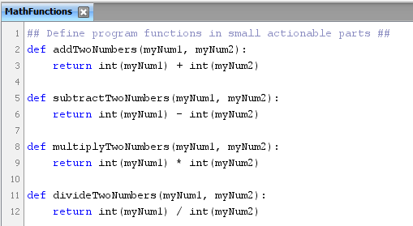
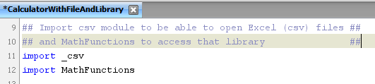

MODULE SAMPLES

Slide 5
APPS

Slide 6
APPS
App is a function of the operating system
Each has a unique pathname
  Can be found by right-click on the Application and then viewing Properties
An app must be opened, and must be closed after the script is done
Multiple apps can be run, but try not to overlap windows
Popup windows and other applications can remove focus. Remember to check!
Try to use the most generic app path possible
  Avoid using User directories unless you are the only one using the script!!!

Slide 7

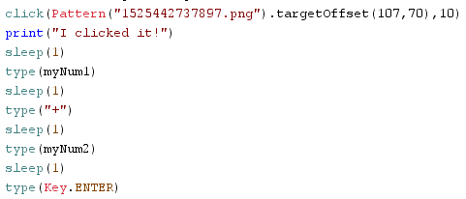
APP EXAMPLES
App Methods:
App.open()
  Opens the app
App.close()
  Closes the app
Sikuli Methods:
Click()
  Performs a mouse click for target area
Type()
  Uses Keyboard functions
  Can be string or special Key
    Needs Key.Notation
  typeDelaySpeed can slow typing if necessary for accuracy
Sleep()
  Rests the CPU to allow for full load time

